Slide 1
Service Registry
Chatchai Kongmanee
Specialist Solution Architect
Red Hat, Thailand

Slide 2
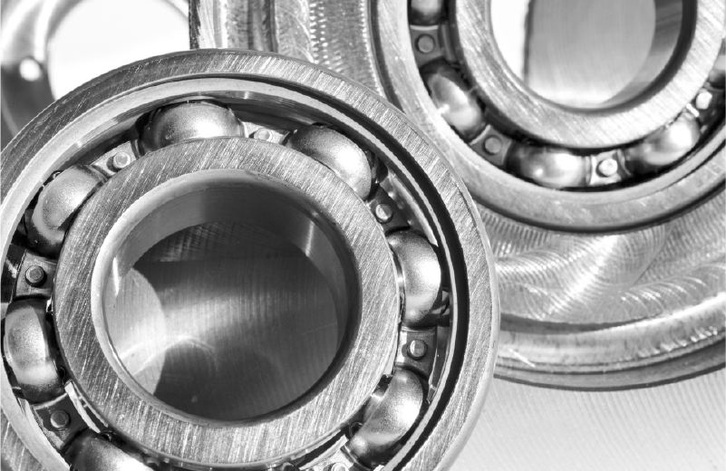


Service Registry
SERVICE REGISTRY
Use Cases
Schema Registry
API Designs
Shared Data Types
Schema registry for Kafka serializers/deserializers.
API specification registry for API consumers.
Shared data types (schemas) across API and Event driven architectures.
Source:
https://github.com/Apicurio/apicurio-registry

Slide 3




Service Registry
SERVICE REGISTRY
Targeted Requirements for Enterprise Registry
Flexibility
Inclusive Artifacts
API Usage
Enterprise Ready
Available for different solutions like Events (Kafka), API management (3scale) and EIPs (Fuse)
Support different artifacts: Avro, Protobuf, JSONSchema, OpenAPI, AsyncAPI, among others
Target usage for OpenAPI, Async API, REST CRUD, UI, Search
Provide Lifecycle Management, Monitoring & Metrics, Operators, Pluggable Storage, validations.
Source:
https://github.com/Apicurio/apicurio-registry

Slide 4



The value of Service Registry
EVENT-DRIVEN ARCHITECTURE
Increased Service Reuse
Faster Application Velocity
Reduce Compatibility Errors
Seamlessly discover schemas and APIs to support application development
Begin developing immediately and continuously respond to change
Smooth upgrade processes by validating and checking schema and API versions

Slide 5
Service Registry
SERVICE REGISTRY
Overview
Datastore for standard event schemas and API designs
Handles following data formats:
Apache Avro
JSON Schema
Protobuf (protocol buffers)
OpenAPI
AsyncAPI
GraphQL
Kafka Connect Schema
Source:
https://github.com/Apicurio/apicurio-registry

Slide 6
Service Registry
SERVICE REGISTRY
Components
Server
Java REST Client
Perform basic operations
Utilities
Kafka Serializer / Deserializer (Serde)
Kafka Connect Converters
Maven Plugin
Register artifacts
Test rules and compatibility
Download artifacts
Storage Option
Streams
Default storage
KeyValueStore as storage
JPA
DB is the storage
Source:
https://github.com/Apicurio/apicurio-registry

Slide 7
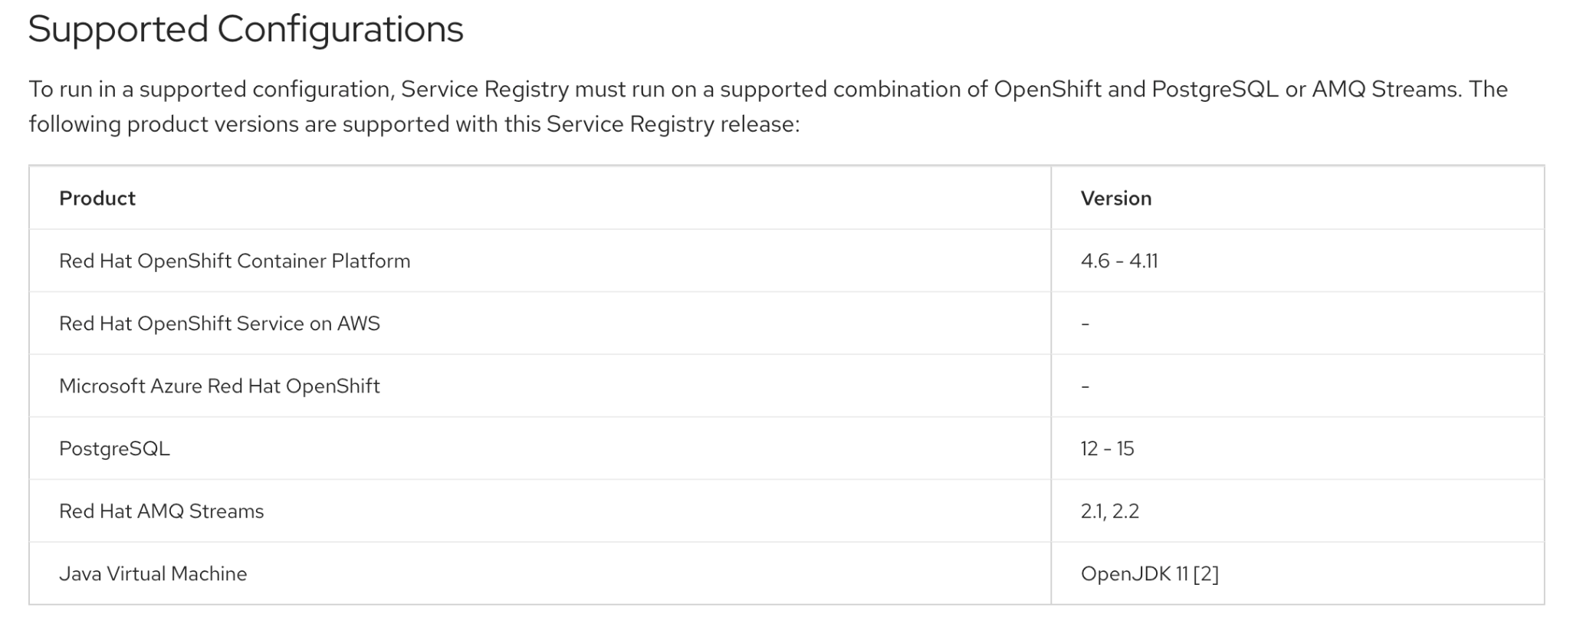
Service Registry
SERVICE REGISTRY
Support Configuration
Source:
https://github.com/Apicurio/apicurio-registry

Slide 8
Artifacts: Schema and API groups
EVENT-DRIVEN ARCHITECTURE
Organize your schemas and APIs in Service Registry
Artifact groups allow teams within organizations to organize a named collection of schemas or API artifacts.
Allow grouping a related set of schemas or API designs
Can be managed by a single entity or team
Allow containing multiple artifact types
Code example for creating an artifact group including Avro schema:
$ curl -X POST -H "Content-type: application/json; artifactType=AVRO" \
-H "X-Registry-ArtifactId: share-price" \
--data '{"type":"record","name":"price","namespace":"com.example", \
"fields":[{"name":"symbol","type":"string"},{"name":"price","type":"string"}]}' \
https://my-registry.example.com/apis/registry/v2/groups/my-group/artifacts

Slide 9
Service Registry
SERVICE REGISTRY
Registry Rules
Validation Rules
Artifact must have valid content or server will reject it
Can check for valid syntax
Can also check for valid semantics (for some artifact types)
Compatibility Rules
Determines whether an update is allowed based on configured compatibility requirement setting.
Multiple compatibility options including Backwards and Forwards compatible
Only relevant for updates (checks the new version against the previous version)
Controls the evolution of a single Artifact over time
Source:
https://github.com/Apicurio/apicurio-registry

Slide 10
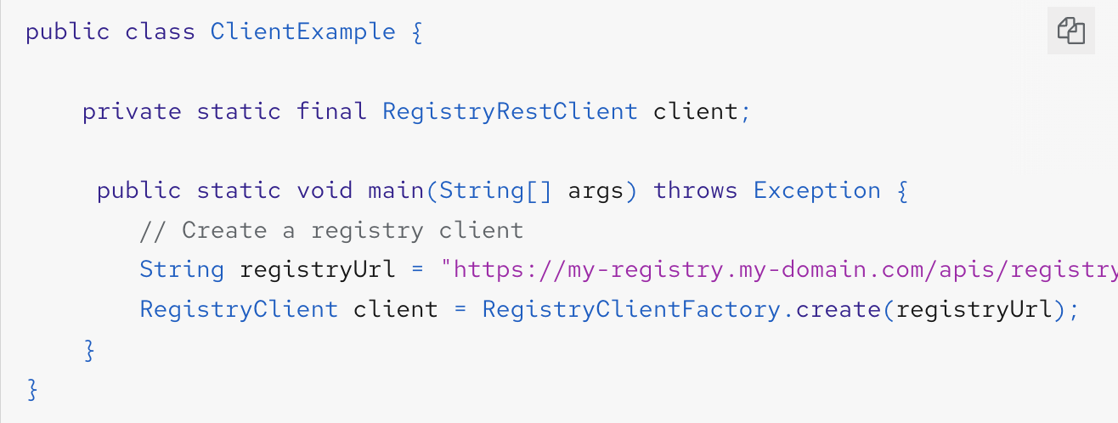
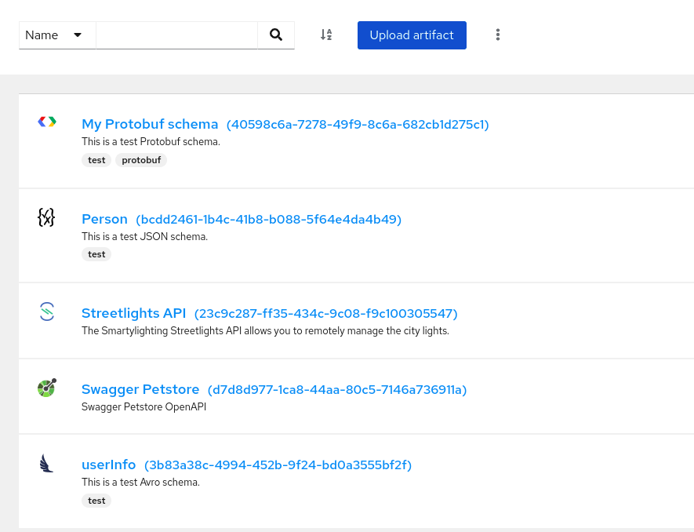

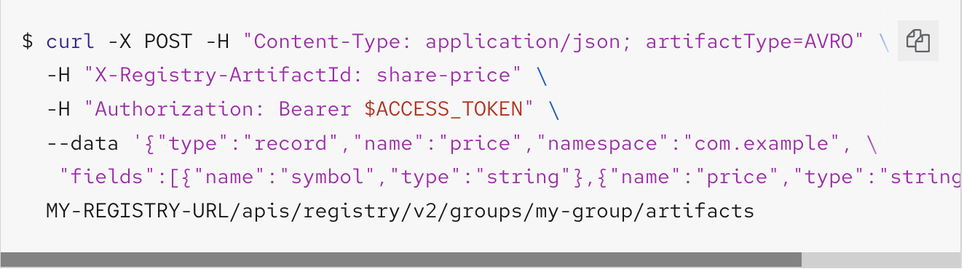
Service Registry
SERVICE REGISTRY
Managing Service Registry content
Maven
Java Client
Web Console
<dependency>
<groupId>io.apicurio</groupId>
<artifactId>apicurio-registry-maven-plugin</artifactId>
<version>1.1.0.Final</version>
<scope>test</scope>
</dependency>
REST API
Source:
https://mvnrepository.com/artifact/io.apicurio/apicurio-registry-maven-plugin/1.1.0.Final

Slide 11
Service Registry for your Kafka Topics
EVENT-DRIVEN ARCHITECTURE
Map your Kafka topics to the appropriate schemas
Governance and centralization
Increased service reuse by providing a source of truth for all schemas.
Decoupling
Improve application efficiency and reduce costs by decoupling the schema from client applications.
Discoverability
Increase visibility over the schema catalog for serialization/deserialization and compatibility.

Slide 12


Apache Kafka schema management with service registry
EVENT-DRIVEN ARCHITECTURE
Service
Registry
Topic A (Avro)
Topic B (JSON)
Topic C (Protobuf)
Get or Register Schema by Id
Retrieve Schema by Id
Producer
| | | | | |
Consumer
Serializer
Deserializer
| | | | | | | |
Send
Serialized Data
| | | | | | |
Retrieve Serialized Data
Apache Kafka
Source:

Slide 13
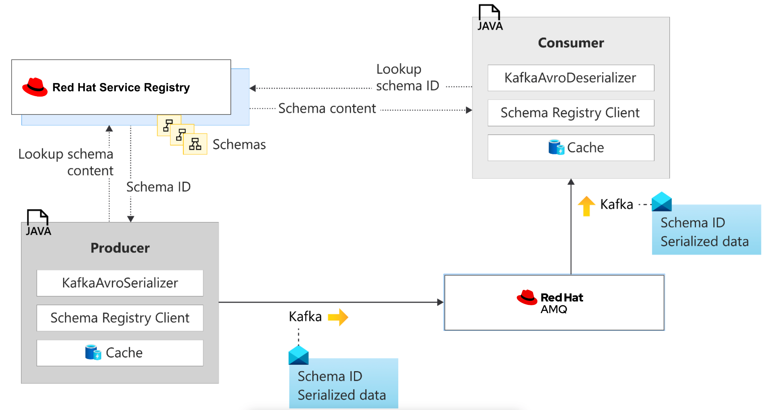
Example : Validating Kafka messages using serializers/deserializers in Java clients

Slide 14
Service Registry for your APIs
EVENT-DRIVEN ARCHITECTURE
Enable teams to set API standards and support partners on API discoverability and usability
Service Registry
Governance - increased service reuse by becoming the source of truth for Open API specifications.
Discoverability - increase visibility over the API library ensuring reusability and compatibility.
Developer
CI pipeline

Slide 15
Thank you

